Slide 1
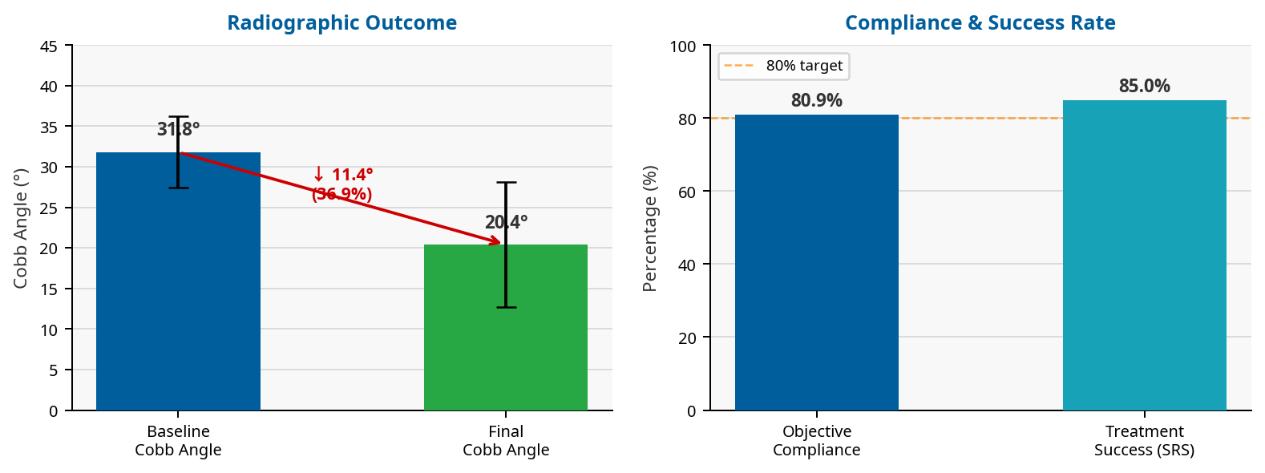
Objective Compliance and Radiographic Outcomes in Lumbar and Thoraco-lumbar Scoliosis Patients Treated with a Novel Adjustable Dynamic TLS Brace: A Pilot Feasibility Study
✦ BAPO
Mohamad Firas Wahbeh | Ortho Med O&P Center | ORCID: 0009-0006-7589-0169
Introduction
2
Method
3
Adolescent Idiopathic Scoliosis (AIS) is a complex three-dimensional spinal deformity affecting skeletally immature patients. Conservative bracing is the established standard of care for moderate curves (Cobb angle 25°–40°) and has demonstrated efficacy in preventing progression to surgical thresholds.
Patient compliance remains the primary determinant of bracing success. Traditional rigid orthoses (Boston, Chêneau) frequently cause discomfort, skin integrity issues, and suboptimal adherence critically undermining treatment outcomes.
The SL/STL brace is a novel custom-molded TLSO incorporating RevoSurface® dial-based cable-tensioning technology, enabling real-time modulation of corrective forces. Theoretical advantages include:
Optimized in-brace correction via precise, adjustable force application
Enhanced patient comfort through dynamic pressure distribution
Facilitation of active 3D correction aligned with PSSE-Schroth principles
Hypothesis: Dynamic adjustability will yield higher compliance, significant Cobb angle reduction, and improved health-related quality of life.
Study Design
Prospective, single-centre, non-comparative consecutive case series. Follow-up: T0 (baseline) → T1 (12 months) → T2 (24 months out-of-brace). Timeline aligned with SOSORT guidelines.
Participants (N = 40)
34 females, 6 males | Mean age 12.9 ± 1.4 years | Risser sign 0–3
Baseline major Cobb angle 31.8 ± 4.4° (range 25°–40°)
Intervention
Custom-molded SL/STL TLSO with RevoSurface® technology, prescribed ≥20 h/day, combined with standardized Schroth-based PSSE (3×/week, 30 min/session, certified therapists).
Outcome Measures
Cobb angle blinded review by two independent radiologists (≥10 years experience)
Objective compliance via integrated temperature sensors
Patient-reported outcomes: SRS-22r & Brace Questionnaire (BrQ)
Success criteria per SRS: ≥6° Cobb reduction or final Cobb ≤20°
Results
4
Primary Radiographic Outcome
Mean major Cobb angle reduced from 31.8° to 20.4° at minimum 24-month out-of-brace follow-up an absolute correction of 11.4° (36.9%).
Objective Compliance
Mean compliance: 80.9 ± 5.5% of prescribed wear time (19.4 ± 1.4 h/day) substantially exceeding the 60–75% typically reported for rigid braces.
Treatment Success
85% of patients (34/40) classified as Improved per SRS criteria. No serious adverse events were reported throughout the study period.
Dose-Response Relationship
A statistically significant positive correlation between compliance and Cobb correction was confirmed (r = +0.446; p = 0.004).
Patient-Reported Outcomes
Mean SRS-22r total score: 4.17 ± 0.38
Mean BrQ score: 79.6 ± 8.6
Table 1. Baseline Characteristics & Clinical Outcomes (N=40)
Outcome Measure
Mean ± SD
Age at Brace Initiation (years)
12.9 ± 1.4
Risser Sign
1.0 ± 1.2
Baseline Major Cobb Angle (°)
31.8 ± 4.4
Final Major Cobb Angle (°)
20.4 ± 7.7
Absolute Correction (°)
11.4 ± 5.3
Percentage Correction (%)
36.9 ± 17.4
Daily Wear Time (h/day)
19.4 ± 1.4
Objective Compliance (%)
80.9 ± 5.5
SRS-22r Total Score
4.17 ± 0.38
BrQ Score
79.6 ± 8.6
Treatment Success (Improved)
85% (34/40)
Discussion
5
The observed objective compliance of 80.9% (19.4 h/day) substantially exceeds the 60–75% typically reported for conventional rigid braces, suggesting that the RevoSurface® adjustable mechanism meaningfully enhances patient adherence through improved comfort — particularly during growth spurts and physical activity.
The mean absolute Cobb angle correction of 11.4° (36.9%) and 85% SRS-defined improvement rate are among the highest reported in the bracing literature. The confirmed dose-response relationship (r = +0.446; p = 0.004) provides mechanistic support for the hypothesis that enhanced compliance drives improved radiographic outcomes.
Key Limitations
Non-randomized, non-comparative, single-center design with no concurrent control group
Significant conflict of interest: the corresponding author is the brace inventor and manufacturer
Potential for selection bias, detection bias, and center-enthusiasm effect
Absence of prospectively collected baseline SRS-22r scores (justified by established population norms: 4.05–4.15)
These findings are strictly hypothesis-generating and cannot be used to claim clinical superiority over established systems. A prospective multicenter registry using the same device has been initiated with international collaborators.
Conclusion
6
References
7
This pilot feasibility series of 40 consecutive AIS patients demonstrates that the novel patient-adjustable dynamic TLSO, combined with Schroth-based PSSE, can achieve:
Substantial curve correction (mean 36.9%; absolute 11.4°)
High objective compliance (80.9%; 19.4 h/day)
85% SRS-defined improvement at ≥24-month follow-up
Confirmed dose-response relationship (r = +0.446; p = 0.004)
These encouraging, hypothesis-generating results justify the urgent need for independent, multicenter, randomised controlled trials before any claims of clinical superiority or generalisability can be made.
1. Weinstein SL, et al. Effects of bracing in adolescents with idiopathic scoliosis. N Engl J Med. 2013;369(16):1512-21.
2. Negrini S, et al. 2016 SOSORT guidelines: orthopaedic and rehabilitation treatment of idiopathic scoliosis during growth. Scoliosis Spinal Disord. 2018;13:3.
3. Richards BS, et al. Standardization of criteria for AIS brace studies: SRS Committee on Bracing. Spine. 2005;30(18):2068-75.
4. Donzelli S, et al. Predictors of clinically meaningful results of bracing in AIS. Children (Basel). 2023;10(4):719.
5. Asher M, et al. Reliability and concurrent validity of the SRS-22 patient questionnaire. Spine. 2003;28(1):63-69.
BAPO Annual Conference | firaswahbeh76@gmail.com | Ortho Med O&P Center

