Slide 1


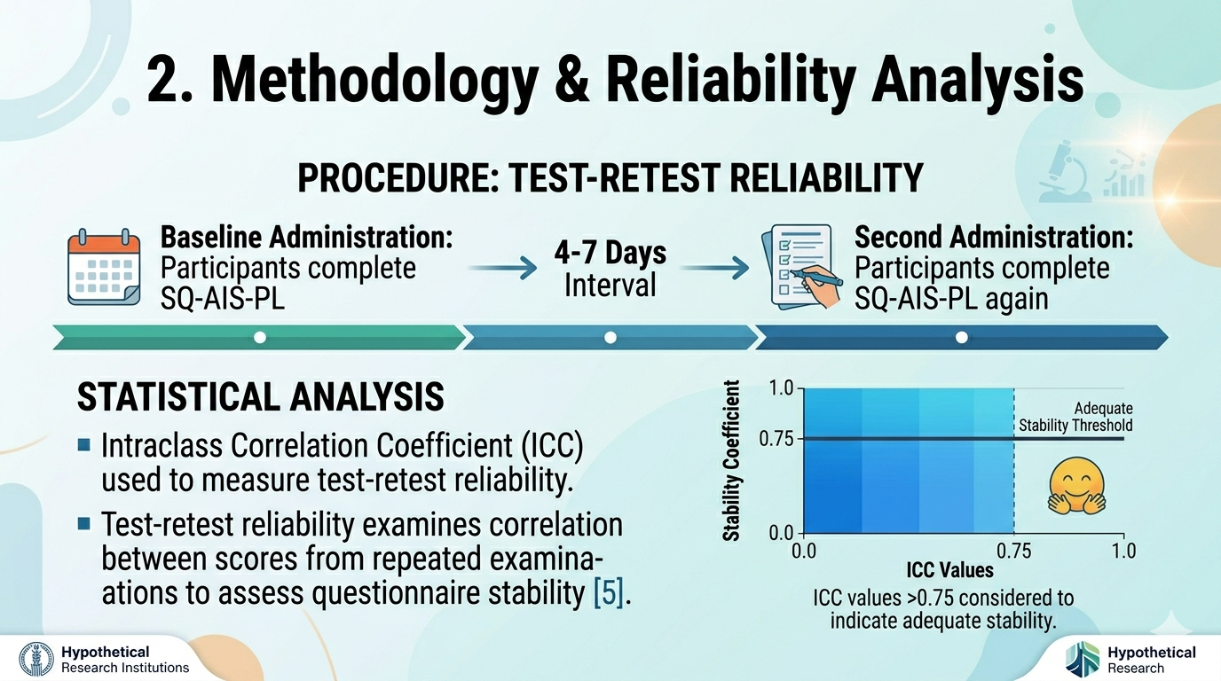
Polish adaptation and validation of Staffordshire Questionnaire for Adolescent Idiopathic Scoliosis
Introduction
Adolescent idiopathic scoliosis (AIS) is the most common form of structural spinal deformity. It affects 1–3% of children and adolescents aged 10–18, significantly impacting their health-related quality of life (HRQoL; [1]). The Scoliosis Research Society-22 Revised Questionnaire (SRQ-22R) is the standard tool for assessing HR-QoL in patients with AIS. Although it is widely used, it has some limitations. Recently, a new questionnaire called the Staffordshire Questionnaire for Adolescent Idiopathic Scoliosis (SQ-AIS) was proposed [2]. Its validity has been confirmed for the original English and Greek versions [3], but not the Polish version. The aim of this study was to adapt and validate the Polish version of the Staffordshire Questionnaire for Adolescent Idiopathic Scoliosis (SQ-AIS-PL).
Methods
The study was conducted according to the Declaration of Helsinki. The cross-cultural adaptation of the English SQ-AIS into Polish was carried out using the six-step method described by Beaton et al. [4], which is the generally accepted and recommended approach.
The study included Polish patients with AIS aged 10–18. Exclusion criteria: visual impairments, severe pathologies, such as neurological disorders, cancer, cognitive impairments or psychiatric disorders.
Both patients and their parents were informed of the study's aims and provided signed consent to participate.
Data analysis was performed using the STATISTICA software package v. 13.3 (StatSoft Poland, Cracow, Poland).
Results
Results
The ICC analysis was conducted separately for each of the six sections of the questionnaire, and globally for the final score.
Table 2. Test–retest reliability of the SQ-AIS-PL
A total of 61 patients with AIS completed the Polish SQ-AIS.
Table 1. Patient characteristics
M – mean, SD – standard devaition, Me – median, Th – thoracic, L -lumbar
 | M | SD | Me | Min. | Max.
age [yrs] | 14 | 2.17 | 15 | 10 | 18
height [m] | 1.62 | 0.08 | 1.63 | 1.40 | 1.83
body mass [kg] | 53 | 11.98 | 54 | 30 | 80
BMI [kg/m2] | 20.16 | 3.17 | 19.94 | 13.95 | 24.97
Cobb angle Th [°] | 22 | 16 | 18 | Not specified | 78
Cobb angle L [°] | 23 | 15 | 19 | Not specified | 65
Treatment | Exercise 49 [80%], Bracing 32 [52%], Surgery 5 [8%], Observation 11 [18%]
 | ICC | 95% CI
SQ-AIS-PL | 0.951 | 0.918-0.970
Section 1. General health | 0.963 | 0.947-0.976
Section 2. Pain | 0.976 | 0.966-0.984
Section 3. Function / activity | 0.906 | 0.868-0.937
Section 4. Self-image / appearance | 0.936 | 0.909-0.957
Section 5. Mental health | 0.944 | 0.921-0.963
Section 6 Intervation | 0.877 | 0.811-0.933
Discussion
Conclusion
The SQ-AIS-PL demonstrated excellent test–retest reliability, consistent with values reported for other scoliosis-related questionnaires in cross-cultural studies (ICC ≈ 0.85–0.95). This supports its stability and reproducibility in assessing health-related quality of life in adolescents with AIS.
Further studies should evaluate its validity in relation to established questionnaires and clinical parameters, such as the Cobb angle.
The study resulted in the development of a Polish-language version of the Staffordshire Questionnaire for Adolescent Idiopathic Scoliosis (SQ-AIS-PL) with
excellent test–retest reliability.
ACKNOWLEDGEMENTS
We would like to thank the authors of the original questionnaire for granting us permission to validate and adapt it culturally. Our thanks also go to the patients who participated in the study.
References
1. S. L. Weinstein, L. A. Dolan, J. C. Cheng, A. Danielsson, and J. A. Morcuende, “Adolescent Idiopathic Scoliosis,” Lancet 371, no. 9623
(May 2008): 1527–1537, https://doi.org/10.1016/S0140-6736(08)60658-3. 2. Leone E, Chockalingam N, Needham R, et al. Development and Preliminary Testing of the Staffordshire Questionnaire for Adolescent Idiopathic Scoliosis (SQ-AIS): Content and Face Validity. Health Sci Rep. 2024;7(11):e70213. Published 2024 Nov 22. doi:10.1002/hsr2.70213 3. Oikonomaki M, Kelalis G, Skouras AZ, Sotiropoulos S, Georgoudis G, Grivas T. Cross-cultural adaptation, reliability and validity of the Greek version of the Spinal Appearance Questionnaire (SAQ) in patients with adolescent idiopathic scoliosis. Spine Deform. 2024;12(6):1623-1629. doi:10.1007/s43390-024-00907-x
4.Beaton DE, Bombardier C, Guillemin F, Ferraz MB. Guidelines for the process of cross-cultural adaptation of self-report measures. Spine (Phila Pa 1976). 2000;25(24):3186-3191. doi:10.1097/00007632-200012150-00014
5. Shrout PE, Fleiss JL (1979) Intraclass correlations: uses in assessing rater reliability. Psychol Bull 86:420–428. https://doi.org/10.1037//0033-2909.86.2.420

